Slide 1
MLA Emerging Technologies and Services Committee (ETSC) Survey
Monday, May 24, 2021

Slide 2
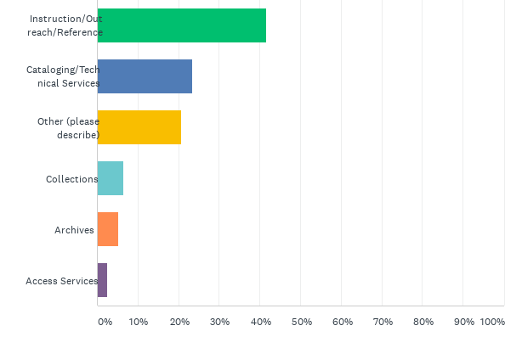
Q1: My position is primarily aligned with:
Answered: 77 Skipped: 0

Slide 3
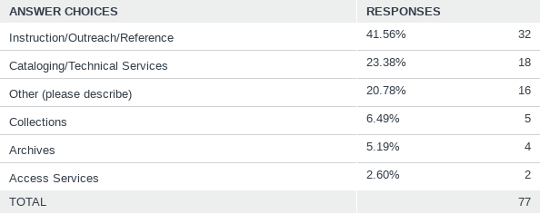
Q1: My position is primarily aligned with:
Answered: 77 Skipped: 0

Slide 4
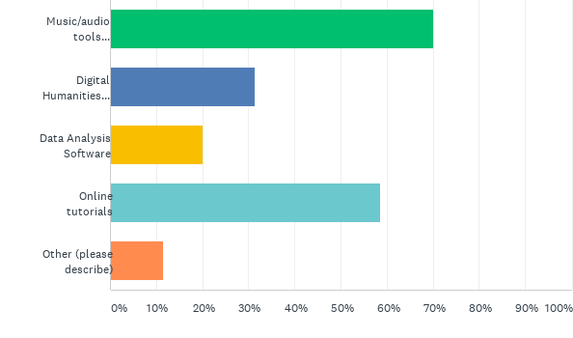
Q2: I have experience with:
Answered: 70 Skipped: 7

Slide 5
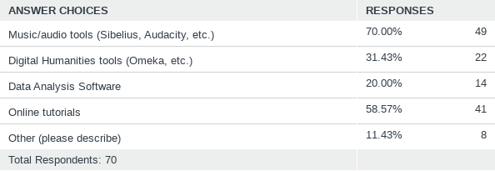
Q2: I have experience with:
Answered: 70 Skipped: 7

Slide 6
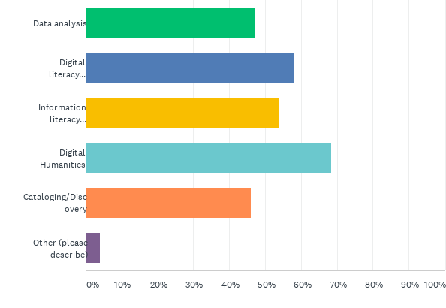
Q3: Emerging topics I’m interested in:
Answered: 76 Skipped: 1

Slide 7
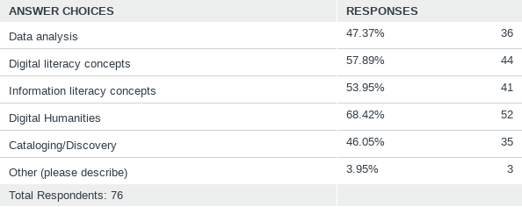
Q3: Emerging topics I’m interested in:
Answered: 76 Skipped: 1

Slide 8
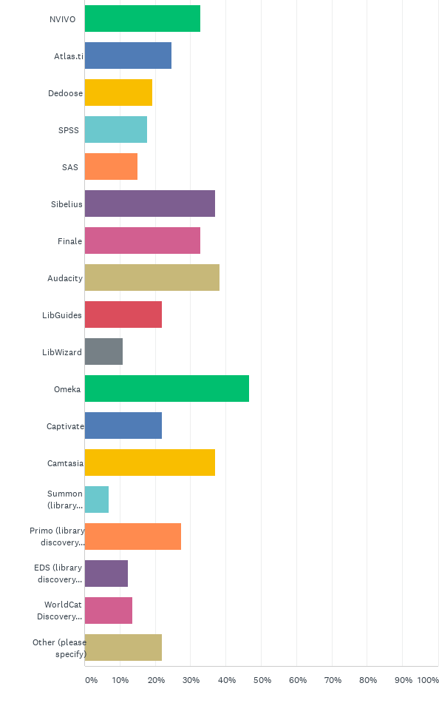
Q4: Specific tools/software I'd like to learn about:
Answered: 73 Skipped: 4

Slide 9
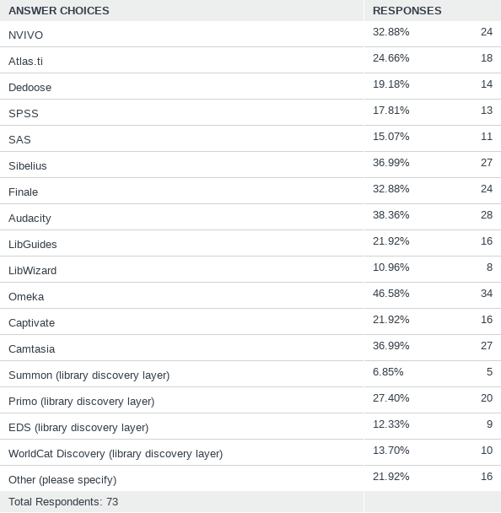
Q4: Specific tools/software I'd like to learn about:
Answered: 73 Skipped: 4

